Slide 1


Slide 2
Hands on with the RedLaser Mobile SDK for iOS
Chall Fry | RedLaser iOS SDK
Notes:
This talk is entitled Hands on with the RedLaser Mobile SDK for iOS.
I’m Chall Fry, lead engineer on the RedLaser iOS SDK team
I’ve been with eBay about 10 months now. I joined eBay when our mobile consulting company was acquired late last year.
I’ve been programming for mobile since 2008, and on Macintoshes since 1990.

Slide 3
Agenda
About RedLaser
What it is
How it works
5 Hands on Lab Activities
Set up project
Add the SDK
Add custom overlay
Add QR Code handling
Enhance overlay with live tracking
Review
Notes:
Here’s what we’re going to cover today.
First I’ll give a brief talk about the RedLaser SDK itself.
Then we have 5 lab activities lined up, covering major features of the SDK.
Finally, we’ll have some time at the end for review and Q&A.
At the end of this lab, you will be able to add RedLaser to your existing app, and within 2 hours have it in a state where you can demo the amazing features to your product manager.
And, you’ll be able to do a complete integration ready to ship as soon as your User Interface person creates graphic assets, and the Product Manager decides he likes the feature,
And the Marketing Department comes up with a marketing plan for the new feature, and your Legal department decides…something.

Slide 4
What You’ll Need
Macintosh with Xcode
iOS Device with a camera
Cable to connect them
Mobileprovision file that lets you install apps on your device.
Basic Objective-C and Cocoa Touch knowledge
Basic debugging skills
Notes:
Wanted to talk about this early, so that anyone who doesn’t meet these requirements can jump into another session.

Slide 5
? I have that app…
Over 10 million downloads
Used throughout eBay mobile’s family of apps
Hundreds of partner companies as well
Wal-Mart
Toyota
Chegg
Groupon
Fast, simple integration
Coming to your app soon
Notes:
Used in: eBay Core for iPhone and iPad, Half.com, Shopping.com, eBay Selling, eBay Motors, Milo, Where.com, coming soon to StubHub and eBay Classifieds.

Slide 6
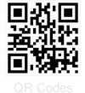
What Does It Do?
Yes, it scans barcodes
Multiple barcodes. At once.
Works on all iOS devices with cameras.
Including the 3G
QR Codes are fully supported

Slide 7
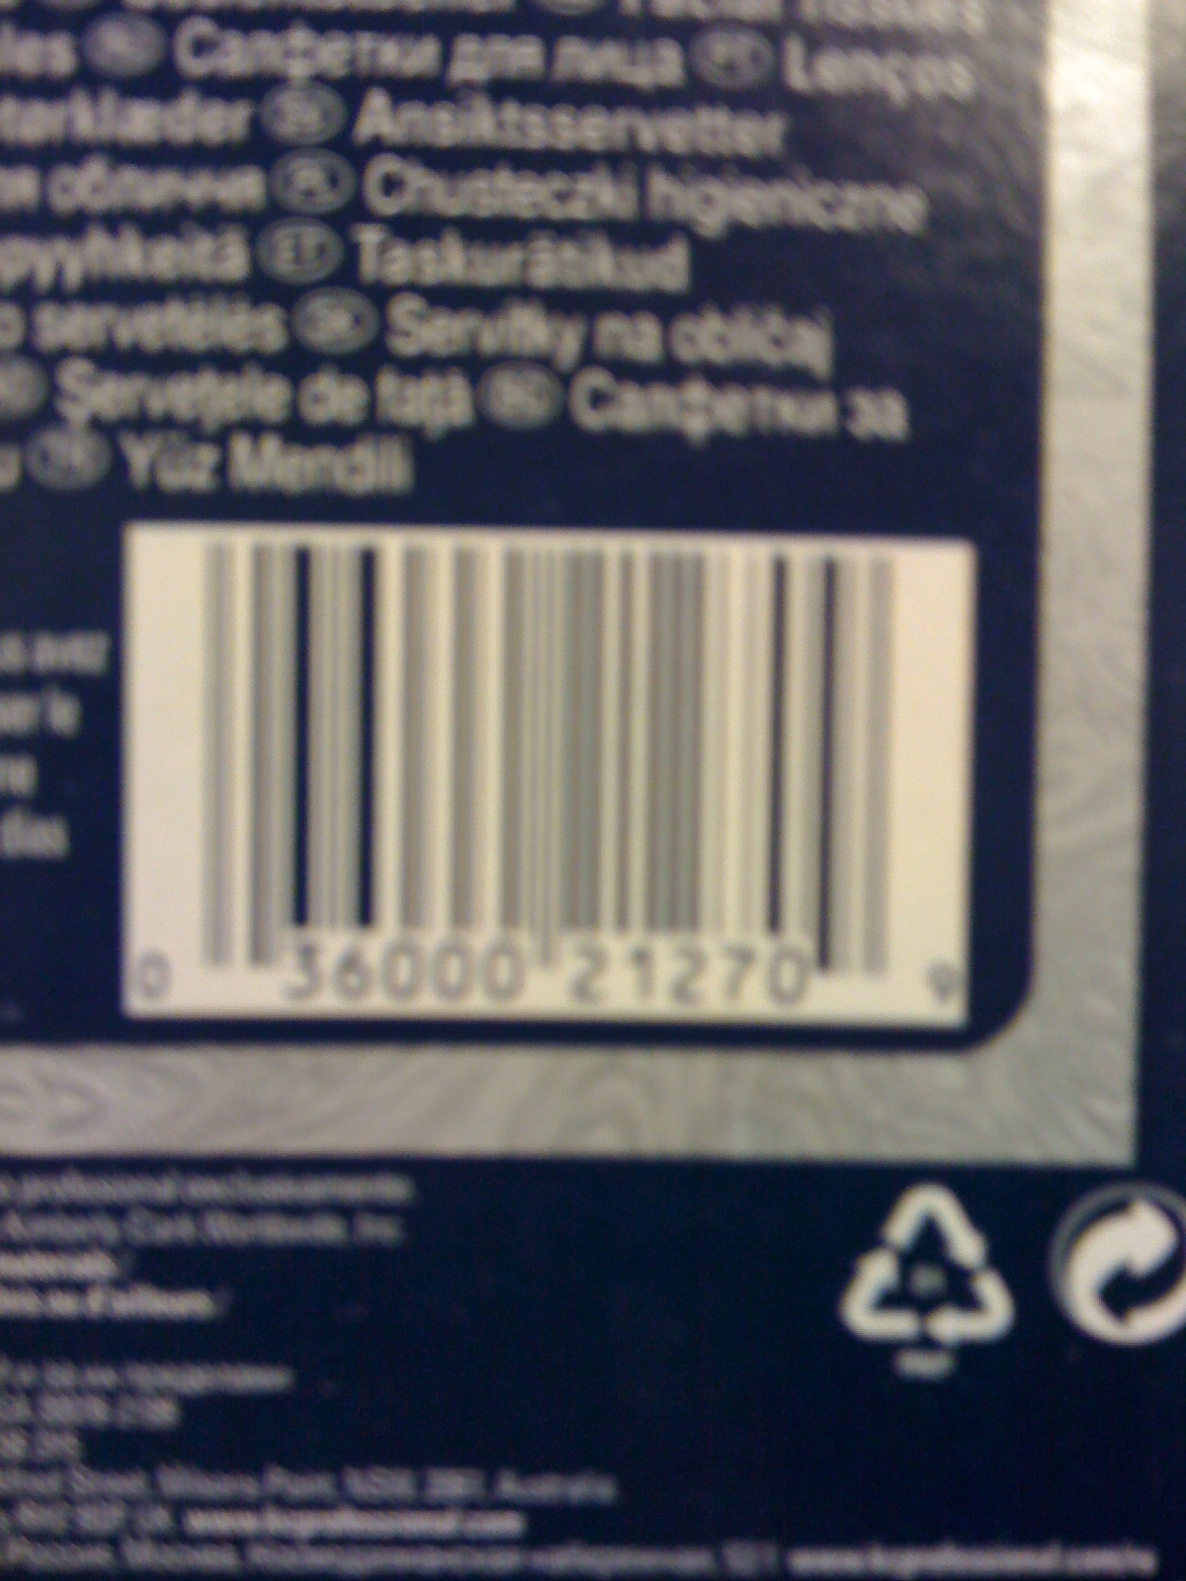
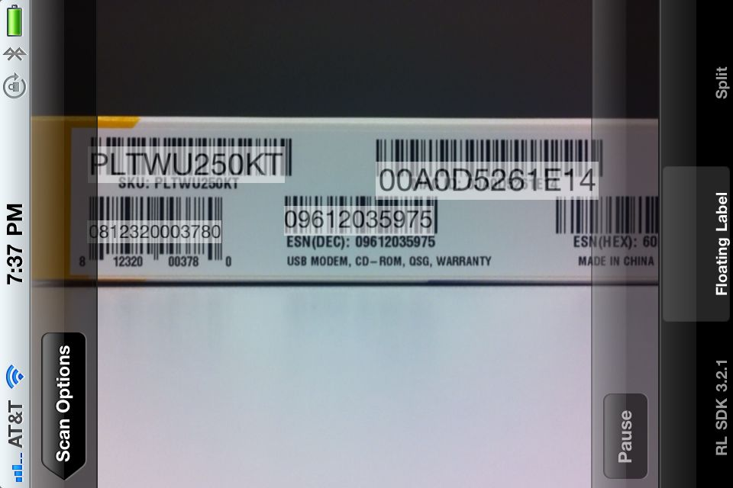
What Does It Do?
Notes:
On the left, this is an actual picture of what the camera on the iPhone 3G sees.
It’s very blurry.
On the right, this is our test app, showing multiple barcodes being recognized at once, with floating labels.

Slide 8
What RedLaser Does Not Do
RedLaser is not a web service. We do not provide a UPC database for external queries.
The SDK tells your app what it saw; it is up to you to interpret it.

Slide 9
RedLaser SDK Licensing
RedLaser has multiple license types, licenses are enforced through a license file that goes into your app
The concept is similar to Apple’s provision files
…But easier. Really.
Go to redlaser.com, sign up as a developer, tell us the bundle IDs of the apps you’re developing, get a license file.

Slide 10

What You’ll Learn Today
You’ll learn how to:
quickly add RedLaser functionality to your app
optimize the SDK’s detection speed on all devices
customize the look of the SDK so it fits the flow of your app
guide the user to successfully complete scans, fast

Slide 11
The Labs
Find the “Labs” folder in your course materials
Each lab has:
An instructions file
A project at the starting point for the lab
A copy of the project, with the lab completed
The labs are chained; you can do the whole session with Lab 1 if you want
But if you get stuck, don’t worry, just open the next lab’s project

Slide 12
Lab 1
This one’s simple. Get the project in Lab 1 running in the Simulator.
Now get it running on your device.
When you can enter a barcode manually and see results, you’re ready to continue!
Notes:
Some attendees will probably have to change the bundle ID so that it matches their provision file.
Some may need to change the Base SDK, or modify other settings, to get the app to run.

Slide 13
Lab 1
(Switch to Mac screen for live demonstation)
Notes:
Some attendees will probably have to change the bundle ID so that it matches their provision file.

Slide 14
Lab 2: Add the RedLaser SDK
Now we have a basic app, time to extend its reach
This lab is 15 minutes, and most of it is changing project settings
When we’re done, you’ll see how easy it is to add RedLaser scanning to your app

Slide 15
Lab 2: Add the RedLaser SDK
Add Required Files:
One Library File
One Header File
Add Required Libraries – already done!
Add a button to RootViewController.xib
Write 2 short functions
Test!

Slide 16
Lab 2: Add the RedLaser SDK
(Switch to Mac screen for live demonstation)

Slide 17
Lab 2 Recap
Not much code
RedLaser uses lots of system libraries
We’re using a modal controller to display RedLaser’s UI, but there are other options

Slide 18
Lab 3: Overlay
We Need an Overlay
This is your chance to customize the scan UI
The overlay is a subclass of CameraOverlayViewController
The overlay is how you guide the user to scan as well as possible

Slide 19
Lab 3: Overlay
Create the Overlay Files
Modify the XIB, adding image and Done button
Modify the Header file
Add the Done button handler
Tell RedLaser about your new Overlay
Extra Credit: Add buttons for Camera Front/Back and Light On/Off buttons as well

Slide 20
Lab 3: Overlay
(Switch to Mac screen for live demonstation)

Slide 21
Lab 3 Recap
This may not be the world’s prettiest overlay, but you have lots of options.
This is how you can make a scan UI that fits with your app.
You can copy RedLaser’s UI as well, but really: you can do better.

Slide 22
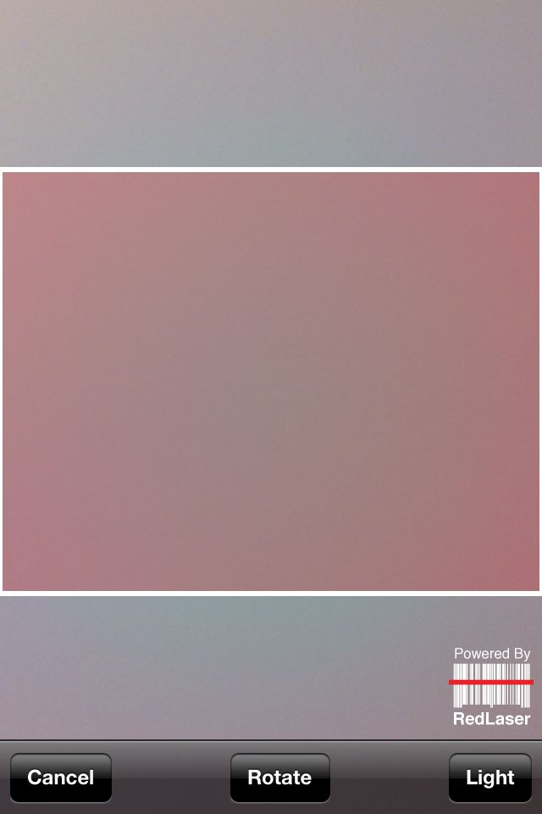
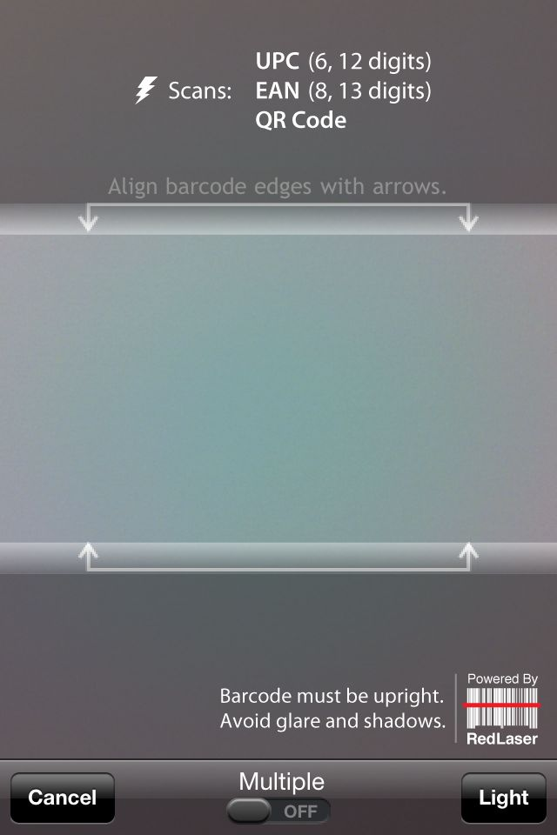
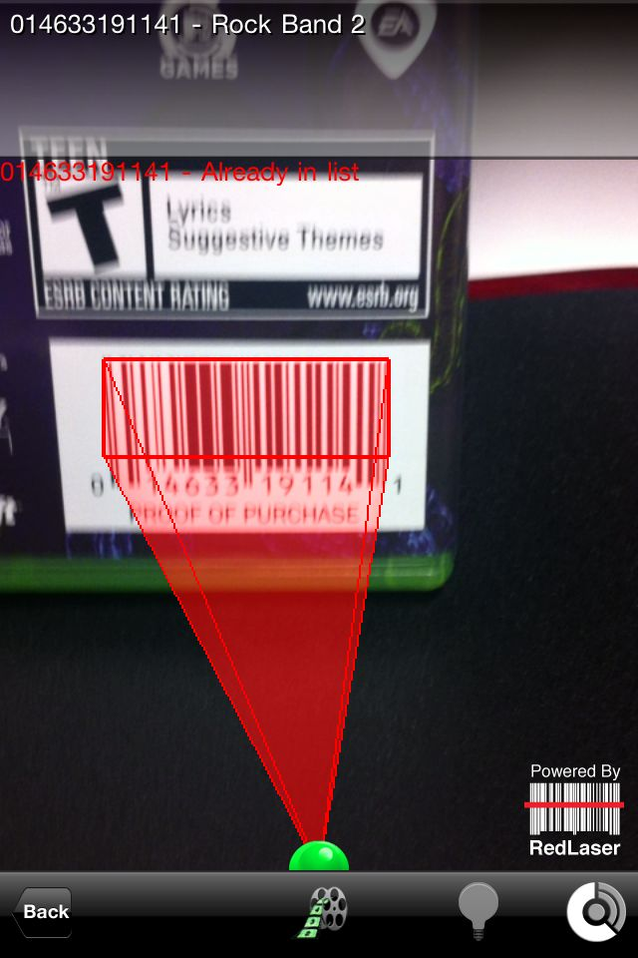
Lab 3 Recap

Slide 23
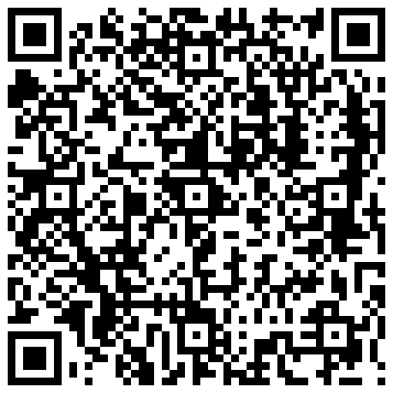
Lab 4: QR Codes
You’ve seen them before
Versatile and compact
Great for getting interested users more info
Now we’ll learn to scan and parse them

Slide 24
Lab 4: QR Codes
Add QR Code Capability
Three parts:
Check for QR Codes in the results
Extract the URL from the QRCodes (the examples are all URLs)
Open the URL using the ProductPage
Extra Credit: Hook the Camera Front/Back and Light On/Off buttons to the SDK

Slide 25
Lab 4: QR Codes
(Switch to Mac screen for live demonstation)

Slide 26
Lab 4 Recap
QR Codes are easy
Generate them online, or in the RedLaser app
Add to almost anything printed
Add to webpages – it’s faster to scan a QR Code on a web page than it is to copy a link to your mobile device

Slide 27
Lab 5: Multiple Codes and Tracking
RedLaser can recognize and track multiple barcodes at once
Why is this important?

Slide 28
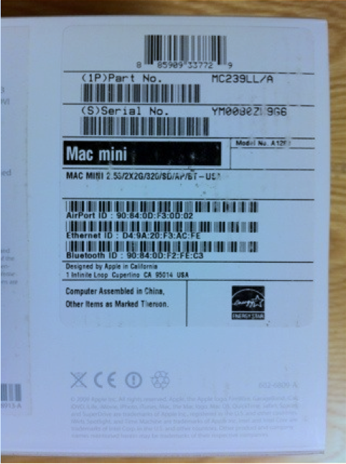
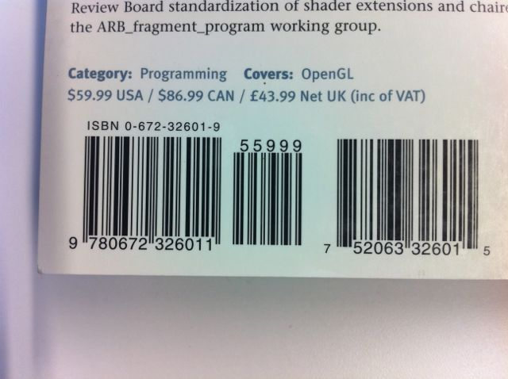
Lab 5: Multiple Codes and Tracking

Slide 29
Lab 5: Multiple Codes and Tracking
The status call in the overlay gets lots of information
We’ll use the barcode rectangle to place a label

Slide 30
Lab 5: Multiple Codes and Tracking
(Switch to Mac screen for live demonstation)

Slide 31
Lab 5 Recap
Multiple barcode scanning is a powerful feature, empowering point-of-sale systems, reading multiple codes from delivery parcels, and associated barcodes
Barcode tracking can be powerful too, giving the user feedback on what’s been scanned while scanning continues

Slide 32
Q & A
Thank you!

